Slide 1
Classification

Slide 2
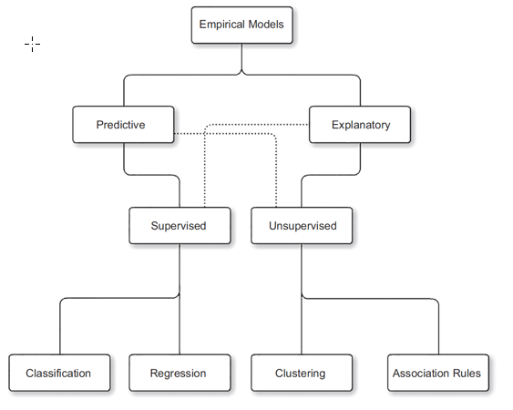
Models

Slide 3
Classification
Target variable is categorical. Predictors could be of any data type.
Algorithms
Decision Trees
Rule induction
kNN
Naive Bayesian
Neural Networks
Support Vector Machines
Ensemble Meta Models

Slide 4
Decision Trees

Slide 5
Play golf dataset
Outlook | Temperature | Humidity | Windy | Play
sunny | hot | high | FALSE | no
sunny | hot | high | TRUE | no
overcast | hot | high | FALSE | yes
rainy | mild | high | FALSE | yes
rainy | cool | normal | FALSE | yes
rainy | cool | normal | TRUE | no
overcast | cool | normal | TRUE | yes
sunny | mild | high | FALSE | no
sunny | cool | normal | FALSE | yes
rainy | mild | normal | FALSE | yes
sunny | mild | normal | TRUE | yes
overcast | mild | high | TRUE | yes
overcast | hot | normal | FALSE | yes
rainy | mild | high | TRUE | no

Slide 6
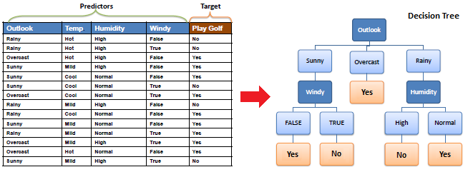
Decision Trees

Slide 7
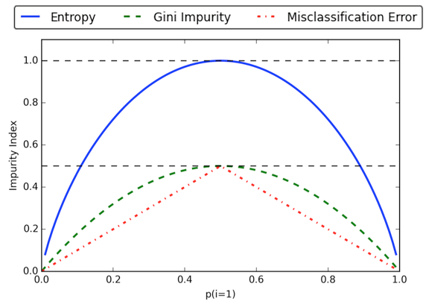
Measure of impurity
Every split ties to make child node more pure.
Gini impurity
Information Gain (Entropy)
Misclassification Error
https://www.quora.com/What-are-the-advantages-of-different-Decision-Trees-Algorithms

Slide 8
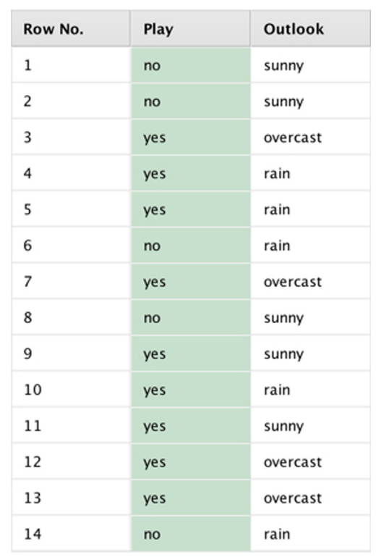
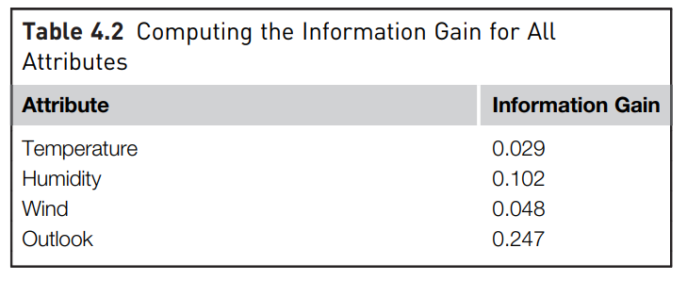

Slide 9
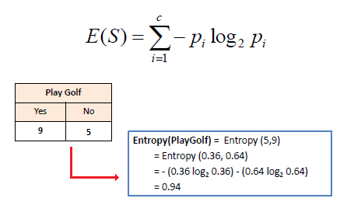
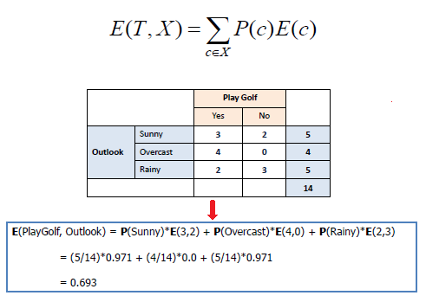
Entropy

Slide 10
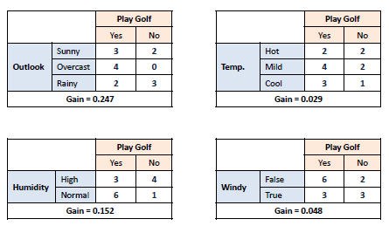
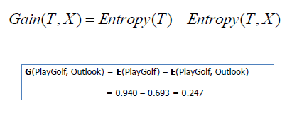
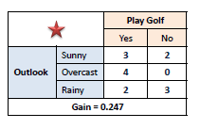






IG

Slide 11
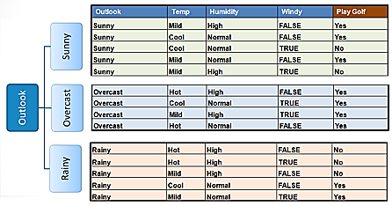
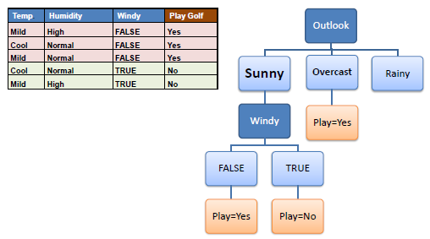
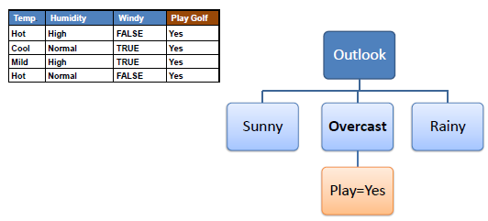
Sub table / sub tree
1
2
3

Slide 12
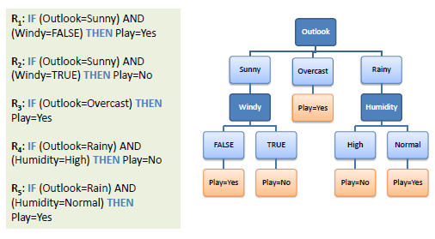
Decision tree – rule extraction

Slide 13
Decision Tree Algorithm
A general algorithm for a decision tree can be described as follows:
Pick the best attribute (highest IG)
Make branches,
for each branch repeat the process for the subset / sub table until one of stop conditions is satisfied.

Slide 14
DT: When to Stop Splitting Data?
No attribute satisfies a minimum information gain threshold
A maximal depth is reached
There are less than a certain number of examples in the current subtree

Slide 15
Rule Induction

Slide 16
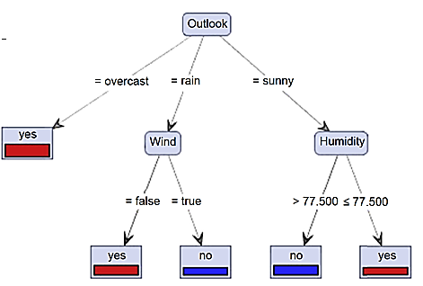
Tree to Rules
Rule 1: if (Outlook = overcast) then yes
Rule 2: if (Outlook = rain) and (Wind = false) then yes
Rule 3: if (Outlook = rain) and (Wind = true) then no
Rule 4: if (Outlook = sunny and (Humidity > 77.5) then no
Rule 5: if (Outlook = sunny and (Humidity ≤ 77.5) then yes

Slide 17
Rules
R = { r₁ ∩ r₂ ∩ r₃ ∩ .. r_{k} }
Where k is the number of disjuncts in a rule set. Individual disjuncts can be represented as
r_{i} = (antecedent or condition) then (consequent)

Slide 18
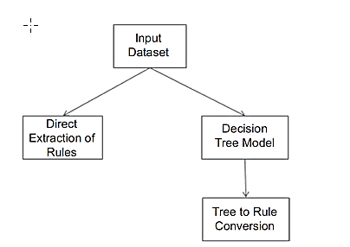
Approaches

Slide 19
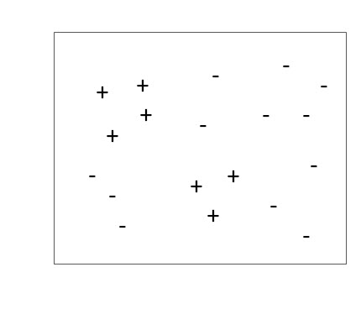
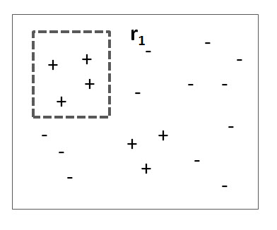
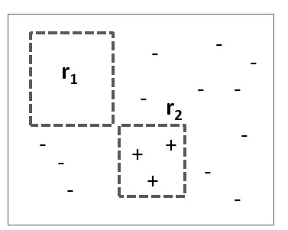
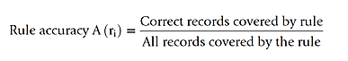
Sequential covering

Slide 20
Rule-based Classifier (Example)
R1: (Give Birth = no) ∧ (Can Fly = yes) → Birds
R2: (Give Birth = no) ∧ (Live in Water = yes) → Fishes
R3: (Give Birth = yes) ∧ (Blood Type = warm) → Mammals
R4: (Give Birth = no) ∧ (Can Fly = no) → Reptiles
R5: (Live in Water = sometimes) → Amphibians

Slide 21
K Nearest Neighbors

Slide 22
KNN
Test Record
Training Records

Slide 23
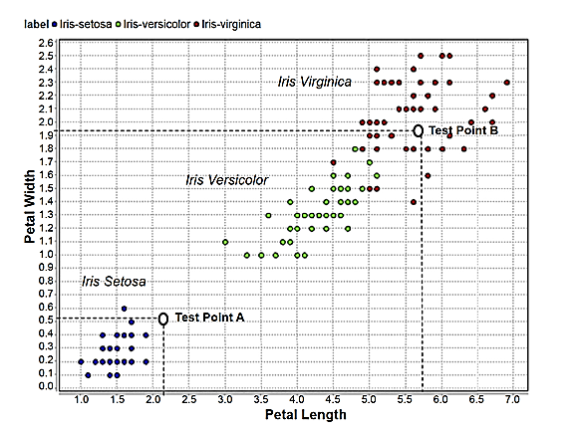
Guess the species for A and B

Slide 24
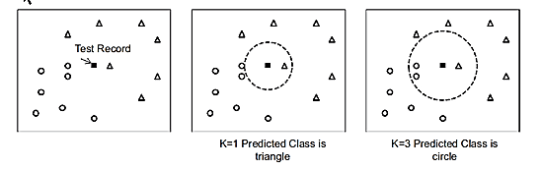
KNN

Slide 25
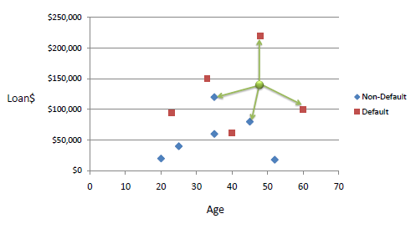
kNN, k=3

Slide 26
Nearest-Neighbor Classifiers
Requires the following:
A set of labeled records
Proximity metric to compute distance/similarity between a pair of records e.g., Euclidean distance
The value of k, the number of nearest neighbors to retrieve
A method for using class labels of K nearest neighbors to determine the class label of unknown record (e.g., by taking majority vote)
Take the majority vote of class labels among the k-nearest neighbors

Slide 27
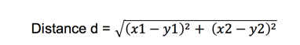
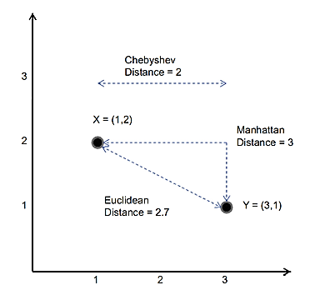
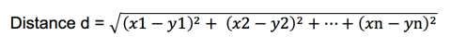
Measure of Proximity
Distance

Slide 28
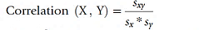
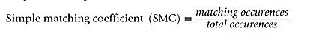
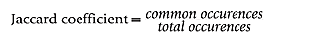
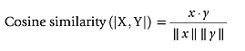
Measure of Proximity
Correlation similarity
Simple matching coefficient
Jaccard Similarity
Cosine similarity

Slide 29
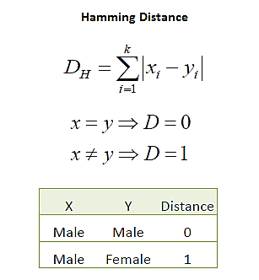
Hamming distance

Slide 30
KNN algorithm steps
Choose the number of nearest neighbors (K) and the distance metric to use.
Train the model by storing the data in memory. Since KNN is a lazy learner, it does not build a model during the training phase. Instead, it stores the training data in memory and uses it to make predictions during the testing phase.
Test the model by making predictions on new data.
To make a prediction for a new data point:
The KNN algorithm calculates the distance between the new data point and all the points in the training dataset.
Then selects the K nearest neighbors based on the chosen distance metric and uses them to make a prediction.
For classification tasks, the prediction is the most common class among the K nearest neighbors. For regression tasks, the prediction is the average of the values of the K nearest neighbors.
Evaluate the model by measuring its performance on the test data. This can be done using metrics such as accuracy, precision, and recall for classification tasks, or mean squared error for regression tasks.

Slide 31
NAÏVE BAYESIAN

Slide 32
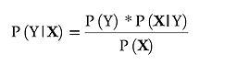
Bayes’ theorem
Probability of the outcome
Class conditional probability
Posterior probability
Probability of the conditions

Slide 33
Bayes Classifier
A probabilistic framework for solving classification problems
Conditional Probability:
Bayes theorem:

Slide 34
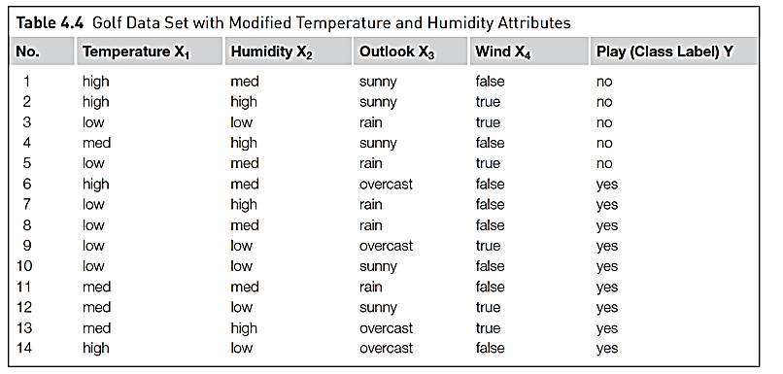
Data set

Slide 35
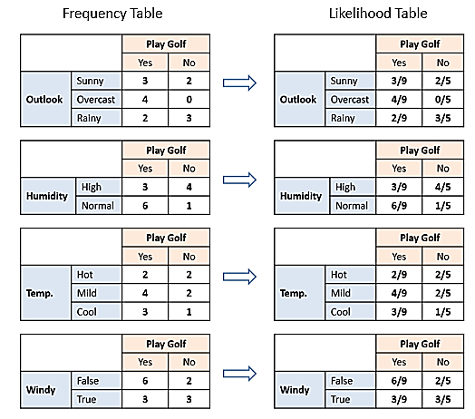

Slide 36
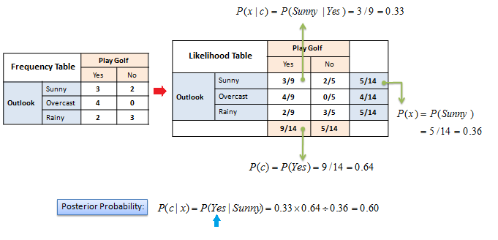

Slide 37
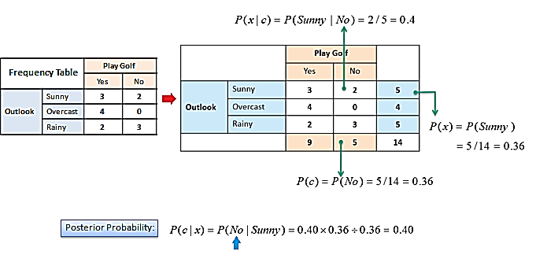

Slide 38
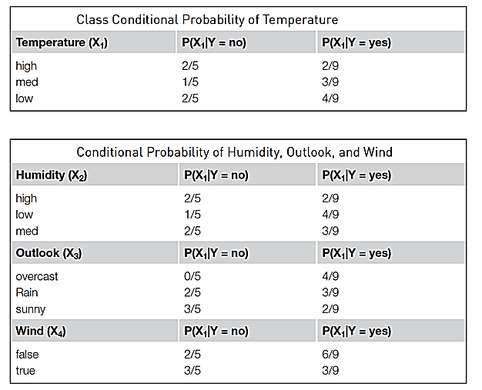
Class conditional probability

Slide 39
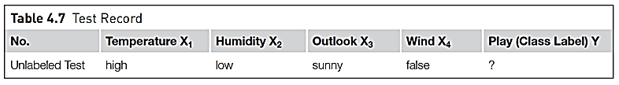
Test record

Slide 40
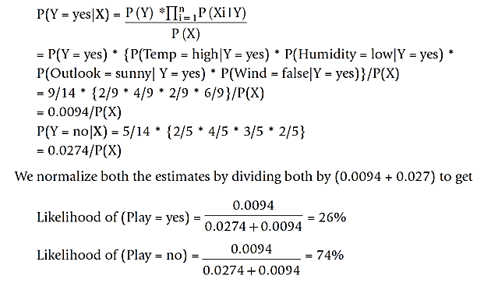
Calculation of posterior probability P(Y/X)
0.0274

Slide 41
Issues
Incomplete training set -> Use laplace correction
Continuous numeric attributes -> Use Probability density function

Slide 42
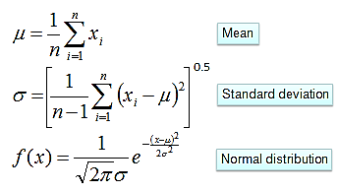
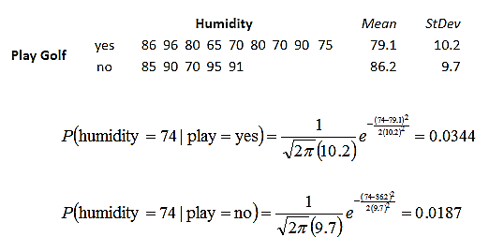
Numerical Predictors

Slide 43
More example NB

Slide 44
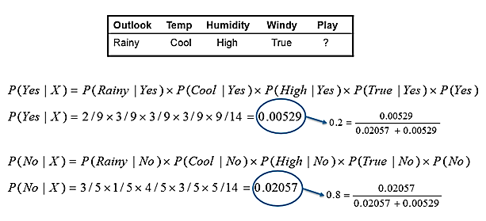

Slide 45
Example of Naïve Bayes Classifier
A: attributes
M: mammals
N: non-mammals
P(A|M)P(M) > P(A|N)P(N)
=> Mammals

Slide 46
NEURAL NETWORKS

Slide 47
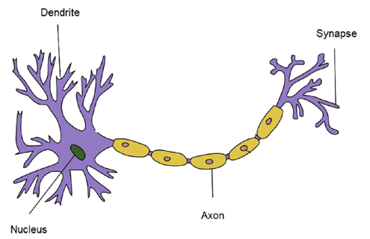
Neurons – biological neuron

Slide 48
Artificial Neural Networks (ANN)
Basic Idea: A complex non-linear function can be learned as a composition of simple processing units
ANN is a collection of simple processing units (nodes) that are connected by directed links (edges)
Every node receives signals from incoming edges, performs computations, and transmits signals to outgoing edges
Analogous to human brain where nodes are neurons and signals are electrical impulses
Weight of an edge determines the strength of connection between the nodes
Simplest ANN: Perceptron (single neuron)

Slide 49
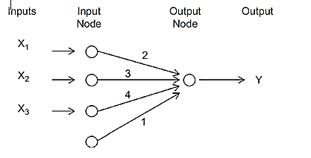
Model
Y = 1 + 2X1 + 3X2 + 4X3

Slide 50
Basic Architecture of Perceptron
Activation Function
Learns linear decision boundaries
Related to logistic regression (activation function is sign instead of sigmoid)

Slide 51
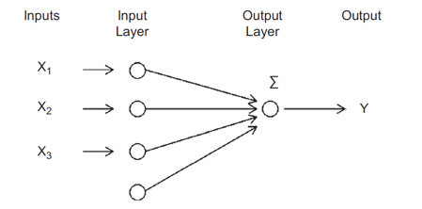
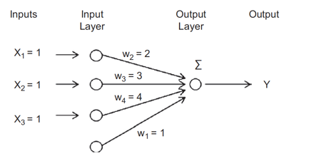
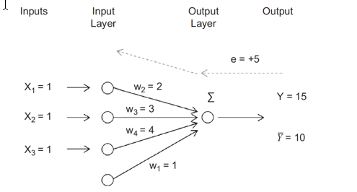
Compute output

Slide 52
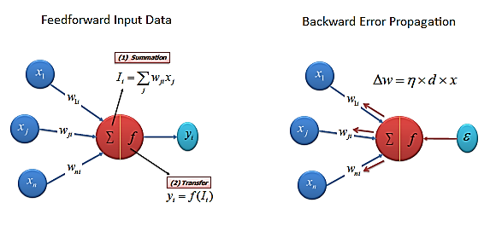
NN training
W_{ij} = W_{ij} + delta

Slide 53
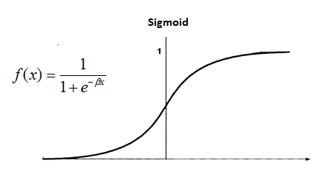
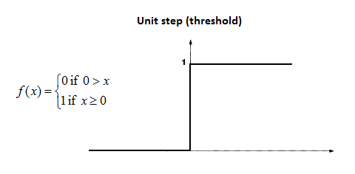


Activation functions

Slide 54

Linear activation function

Slide 55

NN training algorithm
Initialize the weights (w₀, w₁, …, w_{d}) randomly
Repeat
For each training example (x_{i}, y_{i})
Compute $\hat{y_{i}}$
Update the weights:
Until stopping condition is met
k: iteration number; $λ:$ learning rate

Slide 56
Multi-layer Neural Network
More than one hidden layer of computing nodes
Every node in a hidden layer operates on activations from preceding layer and transmits activations forward to nodes of next layer
Also referred to as “feedforward neural networks”
Notes:
Hidden layers represent levels of abstraction. ANN models provide a natural way of representing features at multiple levels of abstraction, where complex features are seen as compositions of simpler features. In many classification problems, modeling such a hierarchy of features turns out to be very useful. For example, in order to detect a human face in an image, we can first identify low-level features such as sharp edges with different gradients and orientations. These features can then be combined to identify facial parts such as eyes, nose, ears, and lips. Finally, an appropriate arrangement of facial parts can be used to correctly identify a human face. ANN models provide a powerful architecture to represent a hierarchical abstraction of features, from
k lower levels of abstraction (e.g., edges) to higher levels (e.g., facial parts).

Slide 57

NN training

Slide 58

Multilayer NN for Iris dataset

Slide 59

Why Multiple Hidden Layers?
Activations at hidden layers can be viewed as features extracted as functions of inputs
Every hidden layer represents a level of abstraction
Complex features are compositions of simpler features
Number of layers is known as depth of ANN
Deeper networks express complex hierarchy of features
Notes:
ANN models provide a natural way of representing features at multiple levels of abstraction, where complex features are seen as compositions of simpler features. In many classification problems, modeling such a hierarchy of features turns out to be very useful. For example, in order to detect a human face in an image, we can first identify low-level features such as sharp edges with different gradients and orientations. These features can then be combined to identify facial parts such as eyes, nose, ears, and lips. Finally, an appropriate arrangement of facial parts can be used to correctly identify a human face. ANN models provide a powerful architecture to represent a hierarchical abstraction of features, from
k lower levels of abstraction (e.g., edges) to higher levels (e.g., facial parts).

Slide 60
Design Issues in ANN
Number of nodes in input layer
One input node per binary/continuous attribute
k or log₂ k nodes for each categorical attribute with k values
Number of nodes in output layer
One output for binary class problem
k or log₂ k nodes for k-class problem
Number of hidden layers and nodes per layer
Initial weights and biases
Learning rate, max. number of epochs, mini-batch size for mini-batch SGD, …

Slide 61
Deep Learning Trends
Training deep neural networks (more than 5-10 layers) could only be possible in recent times with:
Faster computing resources (GPU)
Larger labeled training sets
Algorithmic Improvements in Deep Learning
Responsive activation functions (e.g., RELU)
Regularization (e.g., Dropout)
Supervised pre-training
Unsupervised pre-training (auto-encoders)
Specialized ANN Architectures:
Convolutional Neural Networks (for image data)
Recurrent Neural Networks (for sequence data)
Generative Models: Generative Adversarial Networks GANs

Slide 62

SUPPORT VECTOR MACHINES

Slide 63
Support Vector Machines
Find a linear hyperplane (decision boundary) that will separate the data

Slide 64
Support Vector Machines
One Possible Solution

Slide 65
Support Vector Machines
Another possible solution

Slide 66
Support Vector Machines
Other possible solutions

Slide 67
Support Vector Machines
Which one is better? B1 or B2?
How do you define better?

Slide 68
Support Vector Machines
Find hyperplane maximizes the margin => B1 is better than B2

Slide 69
Support Vector Machines

Slide 70
Linear SVM
Linear model:
Learning the model is equivalent to determining the values of
Find from training data

Slide 71

Boundary

Slide 72

Transforming linearly non-separable data

Slide 73

Optimal hyperplane

Slide 74

SVM kernels

Slide 75
Ensemble Learners

Slide 76
Ensemble model
Wisdom of the Crowd
Meta learners = sum of several base models
Reduces the model generalization error

Slide 77

Ensemble models

Slide 78


